Slide 1
NUCLEAR
ENERGY

Slide 2
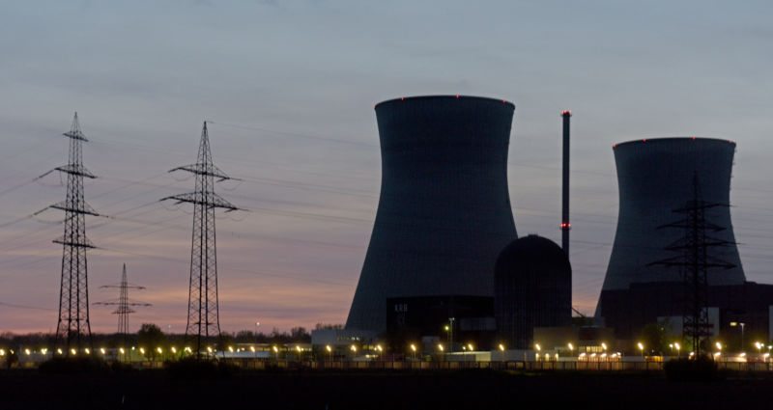
Nuclear energy
Thermal energy
Electricity
Notes:
Basic process- uranium 235 is used to start a chain reaction, neutrons collide with particles in the moderator, kinetic energy turns into thermal energy. That energy is used to turn water into steam, the steam spins and turbine and creates electricity

Slide 3
U
-235
Uranium Enrichment
Increasing the concentration of U-235 in U-238
Critical Mass
Minimum uranium needed to begin chain reaction
Notes:
U-235 is the isotope used to start the chain reaction

Slide 4
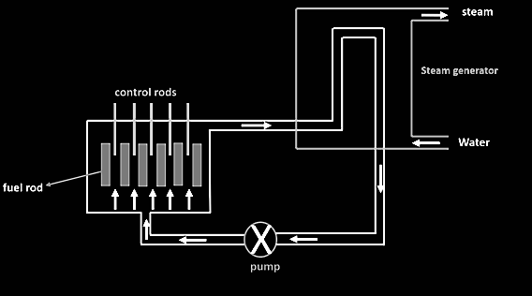
Notes:
The control robs absorb neutrons to control the reactions. Too few and the reaction stops. Too many and it goes out of control
The uranium is kept in the fuel rods

Slide 5
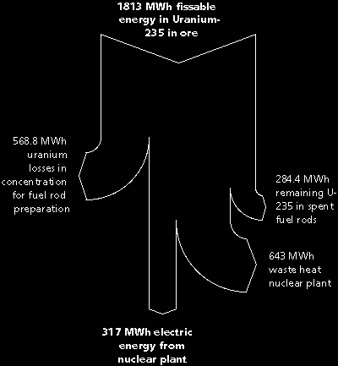
Notes:
Sankey diagram

Slide 6
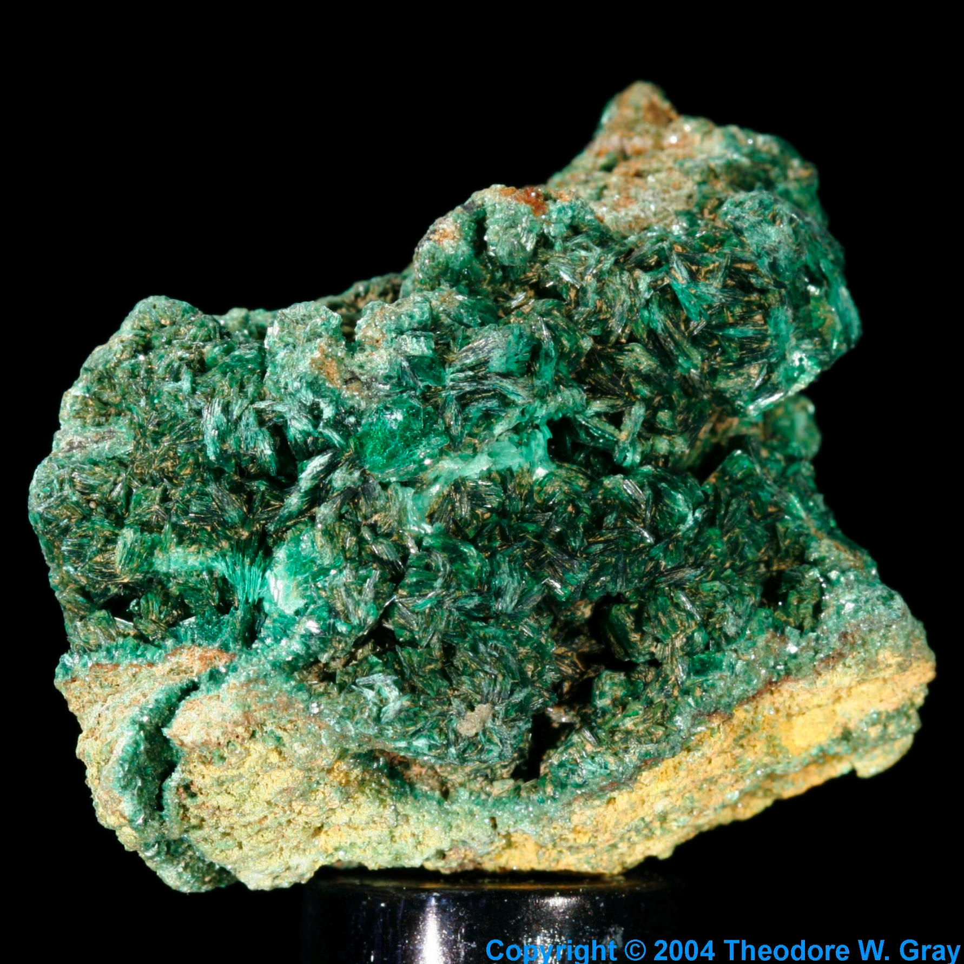
“a single uranium pellet,
slightly larger than a pencil eraser,
contains the same energy
as a ton of coal,
3 barrels of oil,
or 17,000 cubic feet of natural gas.”
Notes:
Advantages- lots of energy!!! A little uranium = a lot of coal
Also we have a lot of uranium so we dont need to worry about resources despite it being non-renewable
Also no greenhouse gases

Slide 7
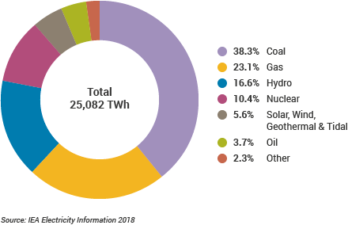
World power
Despite its power, nuclear energy is used less than other energy sources
Notes:
disadvantages

Slide 8
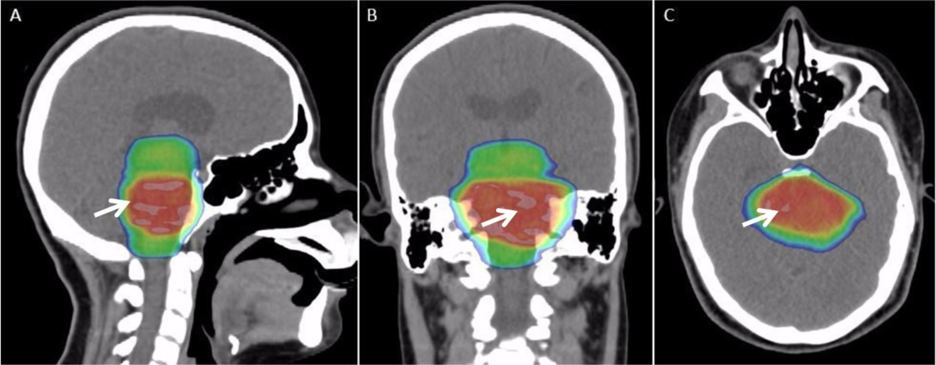
Radiation
Notes:
Radiation has bad side effects, radioactive waste is dangerous

Slide 9
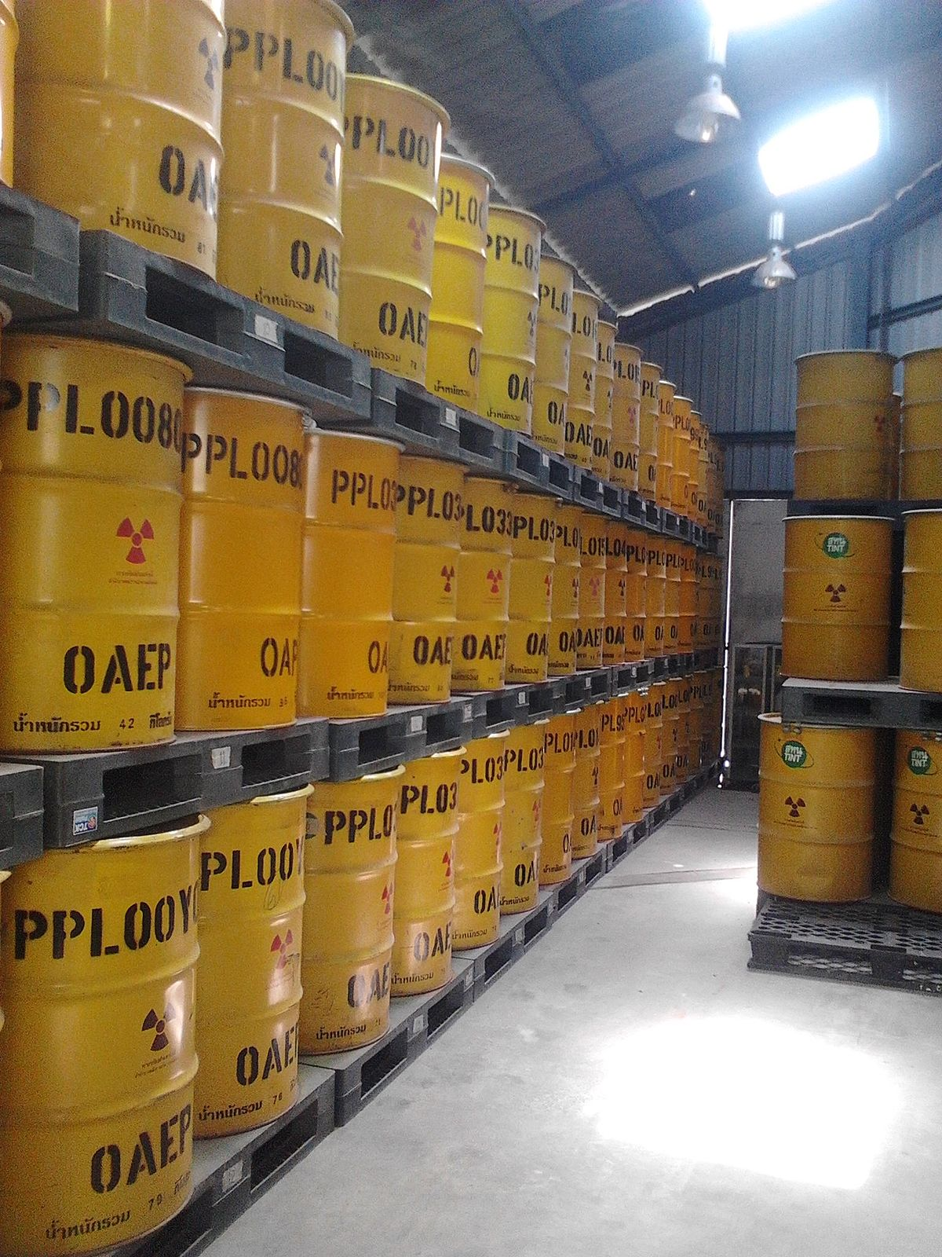
Waste
Notes:
Waste is dangerous and hard to dispose of; you have to seal it and bury it

Slide 10
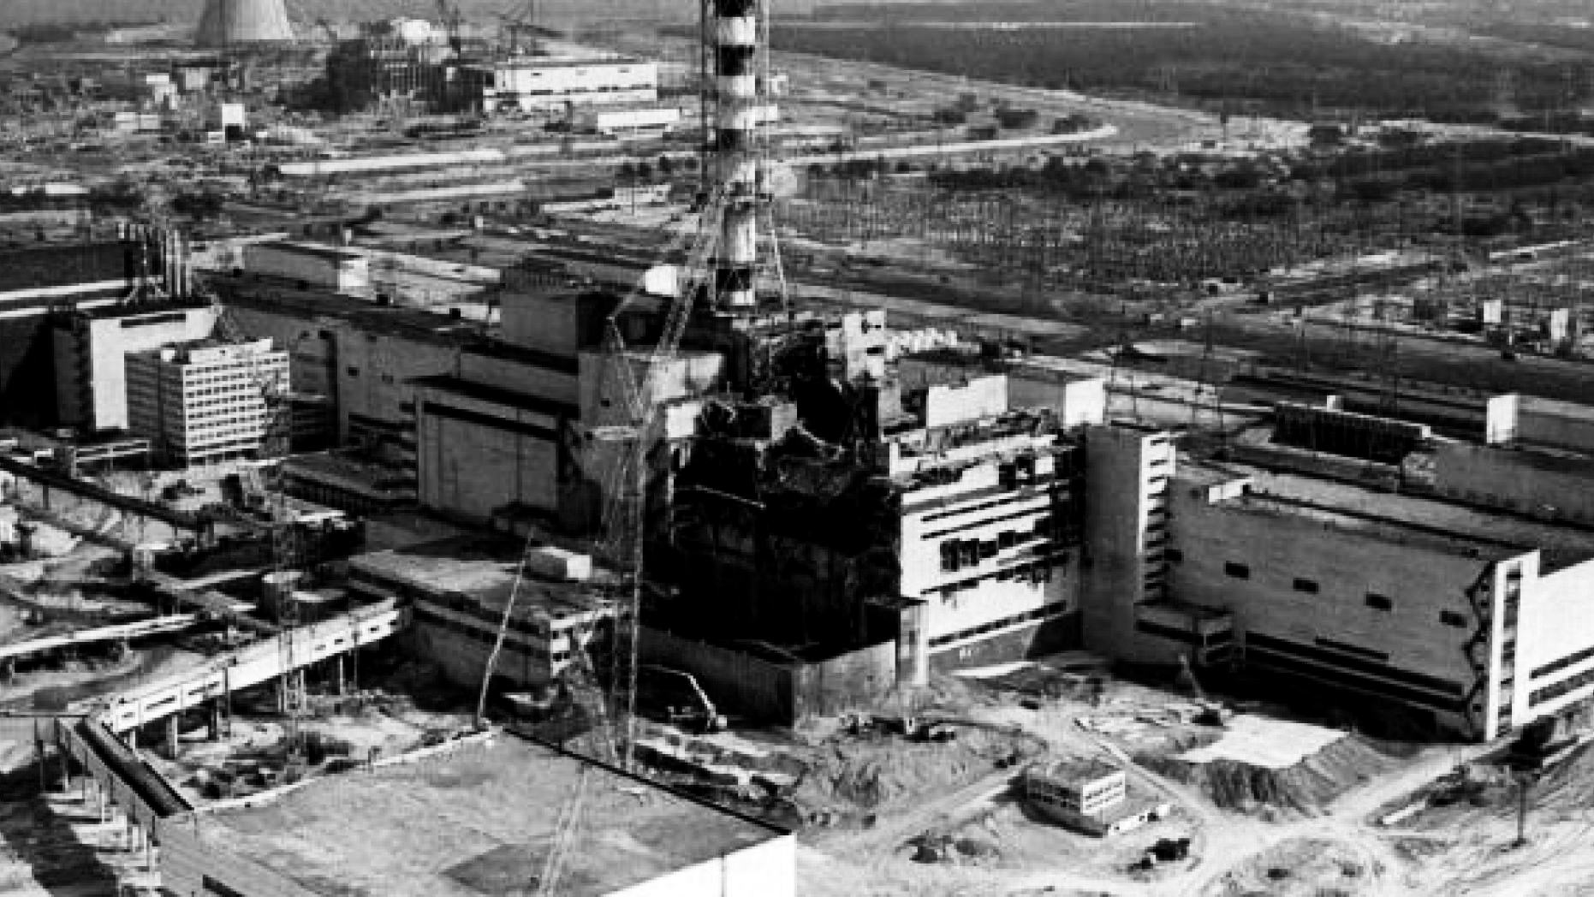
Chernobyl
1986
Notes:
Nuclear power plant disasters- two biggest ones

Slide 11
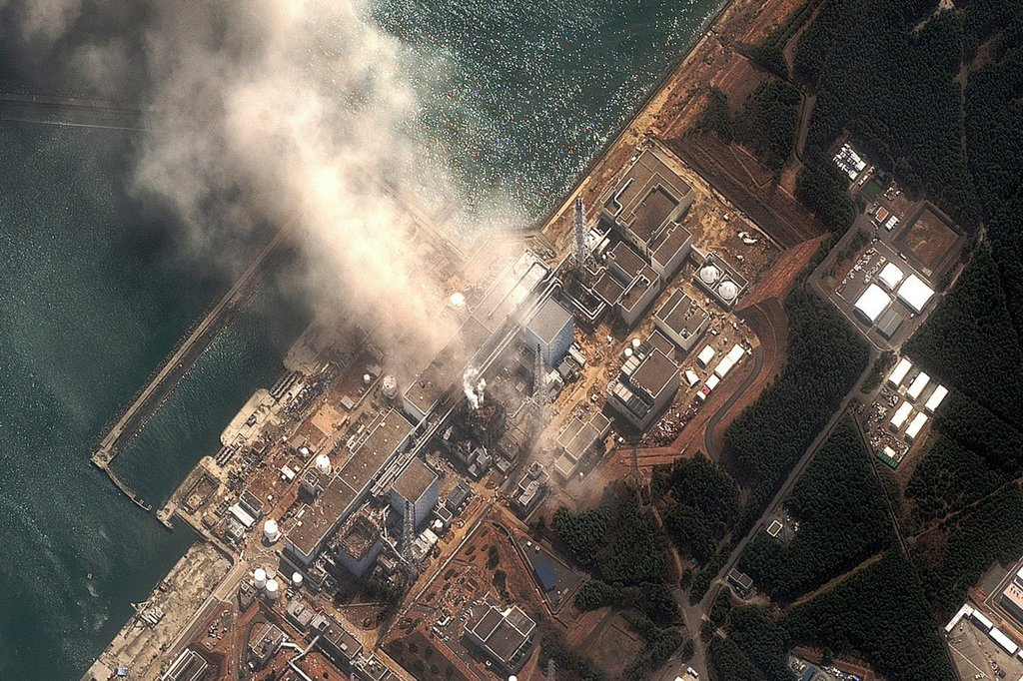
2011
Fukushima
Notes:
Lots of people died

Slide 12
PROBLEM SOLVING
E = Δu
Energy = Atomic mass of Reactants - Atomic mass of Products
Atomic mass is measured with Atomic mass unit, u
1 u = 1 g/mol = 931.5 MeV
Energy is measured with Electronvolt, eV
1 eV = 1.6021766208(98)×10⁻¹⁹ J
1 MeV = 1.602 × 10⁻¹³ J
Notes:
Self explanitory

Slide 13
Calculate the energy released in the following spontaneous fission reaction:
²³⁸U → ⁹⁵Sr + ¹⁴⁰Xe + 3n
given the atomic masses to be
m(²³⁸U) = 238.050784 u
m(⁹⁵Sr) = 94.919388 u
m(¹⁴⁰Xe) = 139.921610 u
m(n) =1.008665 u
Notes:
Example problem

Slide 14
Sources
“Nuclear Power Plants.” Nuclear Power Plants - Energy Explained, Your Guide To Understanding Energy - Energy Information Administration, www.eia.gov/energyexplained/index.php?page=nuclear_power_plants.
“Nuclear Power in the World Today” Nuclear Power Today | Nuclear Energy - World Nuclear Association, www.world-nuclear.org/information-library/current-and-future-generation/nuclear-power-in-the-world-today.aspx.
“What Is Nuclear Power and Energy? | GE Hitachi Nuclear Energy.” Nuclear Power Plants, nuclear.gepower.com/company-info/nuclear-power-basics.
Notes:
sources

